Slide 1
Kubernetes in Action
Part X
2023.04.04
Suho Kwon
(suho.kwon@gmail.com, http://blog.naver.com/knix008)

Slide 2
Extending Kubernetes

Slide 3
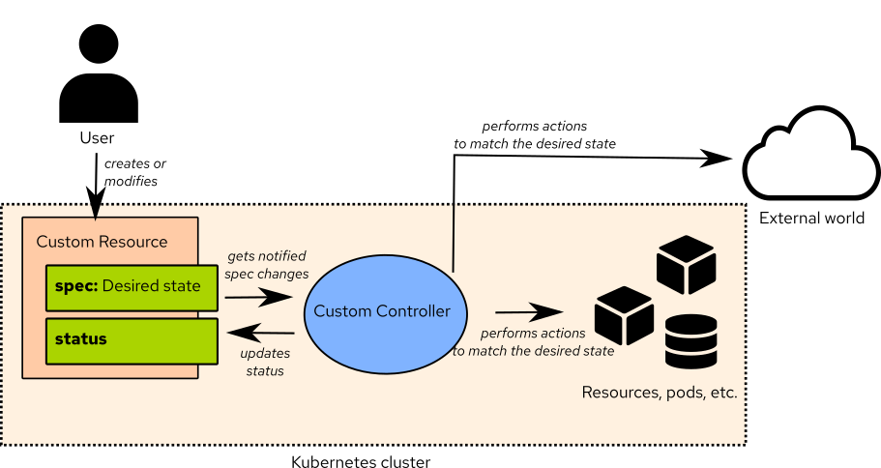
Defining Custom API Objects(1/28)
A Custom Controller :
  You’ve learned about the API objects that Kubernetes provides and how they’re used to build application systems. Currently, Kubernetes users mostly use only these objects even though they represent relatively low-level, generic concepts.
  As the Kubernetes ecosystem evolves, you’ll see more and more high-level objects, which will be much more specialized than the resources Kubernetes supports today. Instead of dealing with Deployments, Services, ConfigMaps, and the like, you’ll create and manage objects that represent whole applications or software services. A custom controller will observe those high-level objects and create low-level objects based on them. For example, to run a messaging broker inside a Kubernetes cluster, all you’ll need to do is create an instance of a “Queue” resource and all the necessary Secrets, Deployments, and Services will be created by a custom Queue controller. Kubernetes already provides ways of adding custom resources like this.

Slide 4
Defining Custom API Objects(2/28)
Introducing CustomResourceDefinitions :
  To define a new resource type, all you need to do is post a “CustomResourceDefinition object (CRD)” to the Kubernetes API server. The “CustomResourceDefinition” object is the description of the custom resource type. Once the CRD is posted, users can then create instances of the custom resource by posting JSON or YAML manifests to the API server, the same as with any other Kubernetes resource.
  NOTE : Prior to Kubernetes 1.7, custom resources were defined through “ThirdPartyResource” objects, which were similar to CustomResourceDefinitions, but were removed in version 1.8.
  Creating a CRD so that users can create objects of the new type isn’t a useful feature if those objects don’t make something tangible happen in the cluster. Each CRD will usually also have an associated controller (an active component doing something based on the custom objects), the same way that all the core Kubernetes resources have an associated controller. For this reason, to properly show what “CustomResourceDefinitions” allow you to do other than adding instances of a custom object, a controller must be deployed as well.

Slide 5
Defining Custom API Objects(3/28)
Introducing the Example CustomResourceDefinition :
  Let’s imagine you want to allow users of your Kubernetes cluster to run static websites as easily as possible, without having to deal with Pods, Services, and other Kubernetes resources. What you want to achieve is for users to create objects of type Website that contain nothing more than the website’s name and the source from which the website’s files (HTML, CSS, PNG, and others) should be obtained. You’ll use a Git repository as the source of those files. When a user creates an instance of the Website resource, you want Kubernetes to spin up a new web server pod and expose it through a Service, as shown in the following figure.
  To create the Website resource, you want users to post manifests along the lines of the one shown in the following listing.
kind: Website
metadata:
name: kubia
spec:
gitRepo: https://github.com/knix008/Website-Example.git

Slide 6
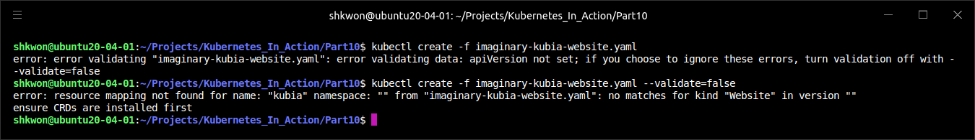
Defining Custom API Objects(4/28)
Introducing the Example CustomResourceDefinition :
  Like all other resources, your resource contains a “kind” and a “metadata.name” field, and like most resources, it also contains a “spec” section. It contains a single field called “gitRepo” (you can choose the name)—it specifies the Git repository containing the website’s files. You’ll also need to include an “apiVersion” field, but you don’t know yet what its value must be for custom resources.
  If you try posting this resource to Kubernetes, you’ll receive an error because Kubernetes doesn’t know what a “Website” object is yet :
  NOTICE : Before you can create instances of your custom object, you need to make Kubernetes recognize them.
$ kubectl create -f imaginary-kubia-website.yaml

Slide 7
Defining Custom API Objects(5/28)
Creating a CustomResourceDefinition Object :
  To make Kubernetes accept your custom “Website” resource instances, you need to post the “CustomResourceDefinition” shown in the following listing to the API server.
apiVersion: apiextensions.k8s.io/v1
kind: CustomResourceDefinition
metadata:
name: websites.extensions.example.com
spec:
scope: Namespaced
group: extensions.example.com
versions:
- name: v1
served: true
storage: true
schema:
openAPIV3Schema:
type: object
properties:
spec:
type: object
properties:
cronSpec:
type: string
image:
type: string
replicas:
type: integer
gitRepo:
type: string
names:
kind: Website
singular: website
plural: websites
website-crd.yaml

Slide 8
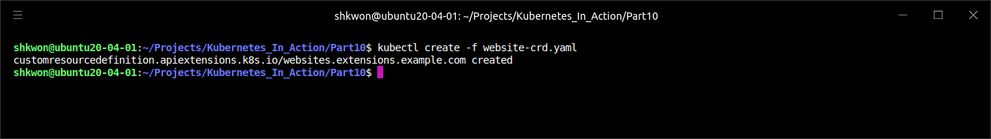
Defining Custom API Objects(6/28)
Creating a CustomResourceDefinition Object :
  After you post the descriptor to Kubernetes, it will allow you to create any number of instances of the custom “Website” resource.
  You can create the CRD from the “website-crd.yaml” file available in the code archive :
  NOTE : For more information, see https://kubernetes.io/docs/tasks/extend-kubernetes/custom-resources/custom-resource-definitions/.
$ kubectl create -f website-crd.yaml

Slide 9
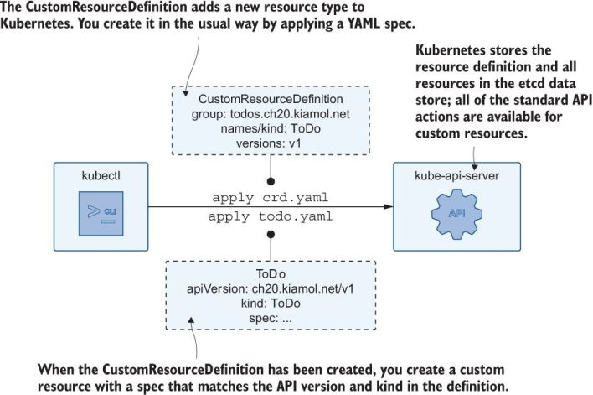
Defining Custom API Objects(7/28)
Creating a CustomResourceDefinition Object :
  You’re wondering about the long name of the CRD. Why not call it “Website”? The reason is to prevent name clashes. By adding a suffix to the name of the CRD (which will usually include the name of the organization that created the CRD), you keep CRD names unique. Luckily, the long name doesn’t mean you’ll need to create your “Website” resources with “kind: websites.extensions.example.com”, but as “kind: Website”, as specified in the “names.kind” property of the CRD. The “extensions.example.com” part is the API group of your resource.
  You’ve seen how creating Deployment objects requires you to set “apiVersion” to “apps/v1” instead of “v1”. The part before the slash is the API group (Deployments belong to the apps API group), and the part after it is the version name (“v1” in the case of Deployments). When creating instances of the custom “Website” resource, the “apiVersion” property will need to be set to “extensions.example.com/v1”.

Slide 10
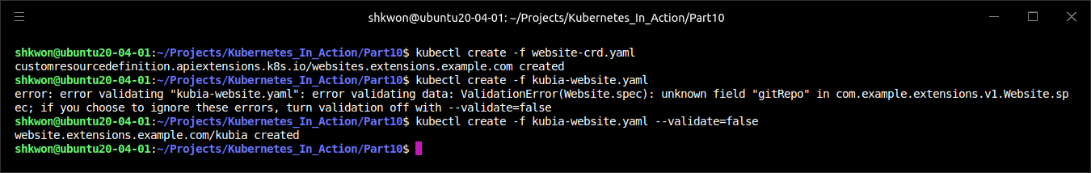
Defining Custom API Objects(8/28)
Creating an Instance of a Custom Resource :
  Considering what you learned, you’ll now create a proper YAML for your “Website” resource instance. The YAML manifest is shown in the following listing.
  The “kind” of your resource is “Website”, and the “apiVersion” is composed of the “API group” and the “version number” you defined in the “CustomResourceDefinition”. Create your “Website” object now :
  NOTE : The response tells you that the “API server” has accepted and stored your custom “Website” object.
apiVersion: extensions.example.com/v1
kind: Website
metadata:
name: kubia
spec:
gitRepo: https://github.com/knix008/Website-Example.git
kubia-website.yaml
$ kubectl create -f kubia-website.yaml

Slide 11
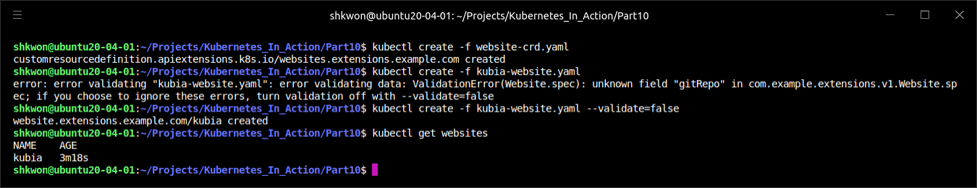
Defining Custom API Objects(9/28)
Retrieving Instances of a Custom Resource :
  List all the “websites” in your cluster :
$ kubectl get websites

Slide 12
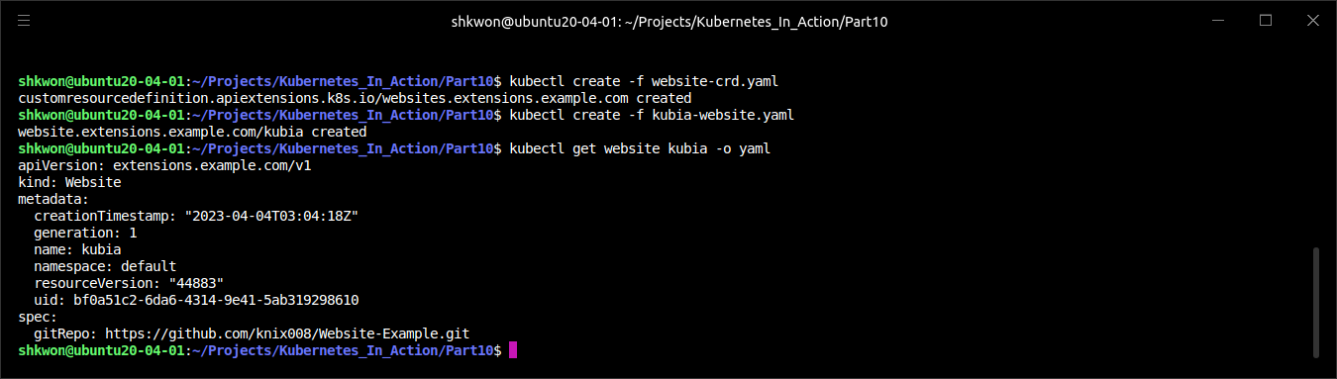
Defining Custom API Objects(10/28)
Retrieving Instances of a Custom Resource :
  As with existing Kubernetes resources, you can create and then list instances of custom resources. You can also use “$ kubectl describe” command to see the details of your custom object, or retrieve the whole YAML with “$ kubectl get” command, as in the following listing.
  Note : The resource includes everything that was in the original YAML definition, and that Kubernetes has initialized additional metadata fields the way it does with all other resources.

Slide 13
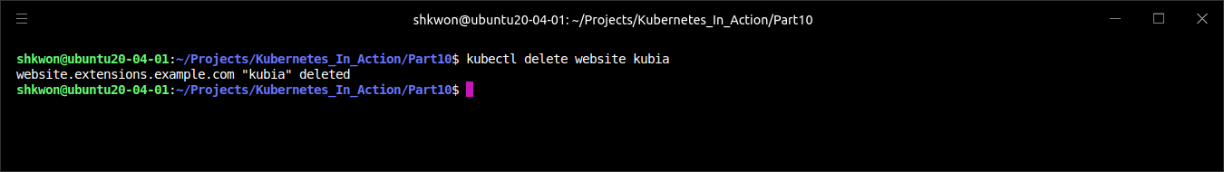
Defining Custom API Objects(11/28)
Deleting an Instance of a Custom Object :
  Obviously, in addition to creating and retrieving custom object instances, you can also delete them :
  NOTE : You’re deleting an instance of a Website, not the Website CRD resource. You could also delete the CRD object itself, but let’s hold off on that for a while, because you’ll be creating additional Website instances later.
$ kubectl delete website kubia

Slide 14
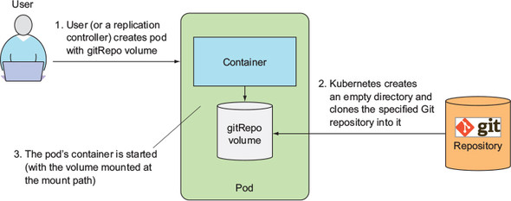
Defining Custom API Objects(12/28)
Deleting an Instance of a Custom Object :
  By creating a “CustomResourceDefinition” object, you can now store, retrieve, and delete custom objects through the Kubernetes API server. These objects don’t do anything yet. You’ll need to create a controller to make them do something.
  In general, the point of creating custom objects like this isn’t always to make something happen when the object is created. Certain custom objects are used to store data instead of using a more generic mechanism such as a “ConfigMap”. Applications running inside pods can query the API server for those objects and read whatever is stored in them.
  But in this case, we said you wanted the existence of a “Website” object to result in the spinning up of a web server serving the contents of the “Git repository” referenced in the object.

Slide 15
Defining Custom API Objects(13/28)
Automating Custom Resources with Custom Controllers :
  To make your ”Website objects” run a web server pod exposed through a “Service”, you’ll need to build and deploy a “Website controller”, which will watch the API server for the creation of “Website objects” and then create the “Service” and the “web server Pod” for each of them.
  To make sure the Pod is managed and survives node failures, the controller will create a “Deployment” resource instead of an unmanaged Pod directly. The controller’s operation is summarized in the following figure.

Slide 16
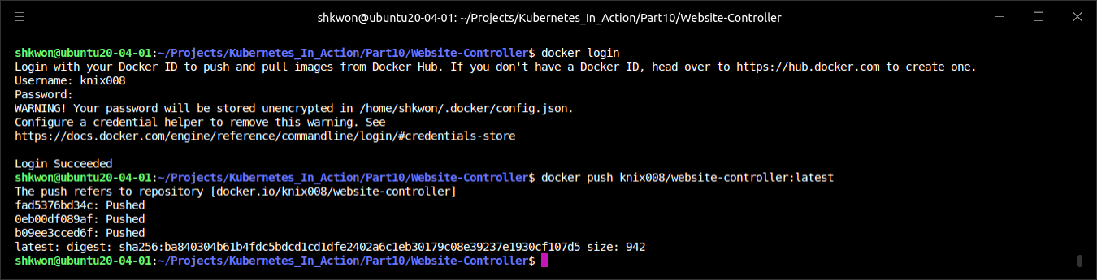
Defining Custom API Objects(14/28)
Automating Custom Resources with Custom Controllers :
  The simple initial version of the controller works well enough to show CRDs and the controller in action, but it’s far from being production-ready, because it’s overly simplified. The container image is available at “hub.docker.com/knix008/website-controller:latest”, and the source code is at “https://github.com/knix008/Kubernetes_In_Action/Part10/Website-Controller”.
  NOTICE : Before you run “$ make” command in the project directory, be sure that your Go compiler is installed after deleting previous version of Go compiler completely.
  To build binary and docker image, just run “$ make image” command in the project directory. After that, you need to login “docker hub”. Then, run “docker push” command.

Slide 17
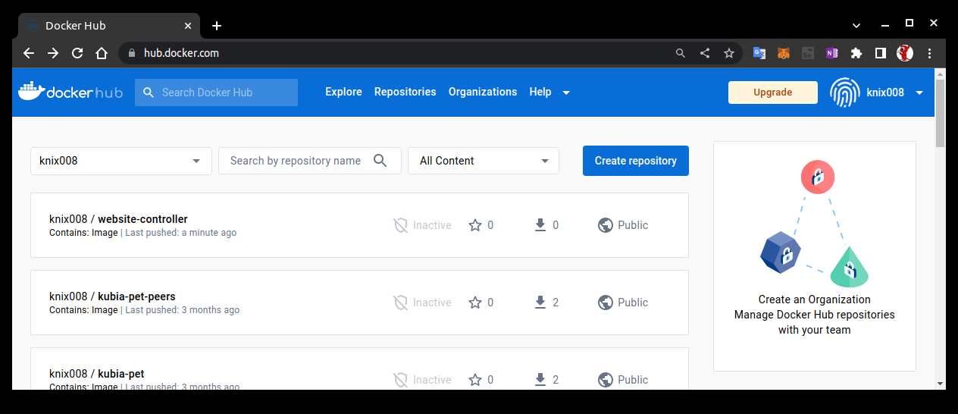
NOTE : The Docker Hub
Website Controller Registration :
  After finishing the previous step, you can check your docker image in your docker hub repository like the following screenshot.

Slide 18
Defining Custom API Objects(15/28)
Understanding What the Website Controller Does :
  Immediately upon startup, the controller starts to watch “Website objects” by requesting the following URL :
  You may recognize the “hostname” and “port”—the controller isn’t connecting to the “API server” directly, but is instead connecting to the “kubectl proxy” process, which runs in a “sidecar container” in the same pod and acts as the “ambassador” to the “API server” (we examined the “ambassador pattern”). The proxy forwards the request to the API server, taking care of both “TLS encryption and authentication” (see the following figure).
http://localhost:8001/apis/extensions.example.com/v1/websites?watch=true

Slide 19
Defining Custom API Objects(16/28)
Understanding What the Website Controller Does :
  Through the connection opened by this “HTTP GET request”, the API server will send watch events for every change to any “Website” object.
  The API server sends the “ADDED” watch event every time a new Website object is created. When the controller receives such an event, it extracts the “Website’s name” and “the URL of the Git repository” from “the Website object” it received in the watch event and creates a “Deployment” and a “Service” object by posting their JSON manifests to the API server.
  The Deployment resource contains a template for a pod with two containers (shown in the following figure) : one running an “nginx” server and another one running a “gitsync” process, which keeps a local directory synced with the contents of a Git repo. The local directory is shared with the nginx container through an “emptyDir” volume (you did something similar, but instead of keeping the local directory synced with a Git repo, you used a “gitRepo volume” to download the Git repo’s contents at pod startup; the volume’s contents weren’t kept in sync with the Git repo afterward). The Service is a “NodePort” Service, which exposes your web server pod through a random port on each node (the same port is used on all nodes). When a pod is created by the Deployment object, clients can access the website through the node port.

Slide 20
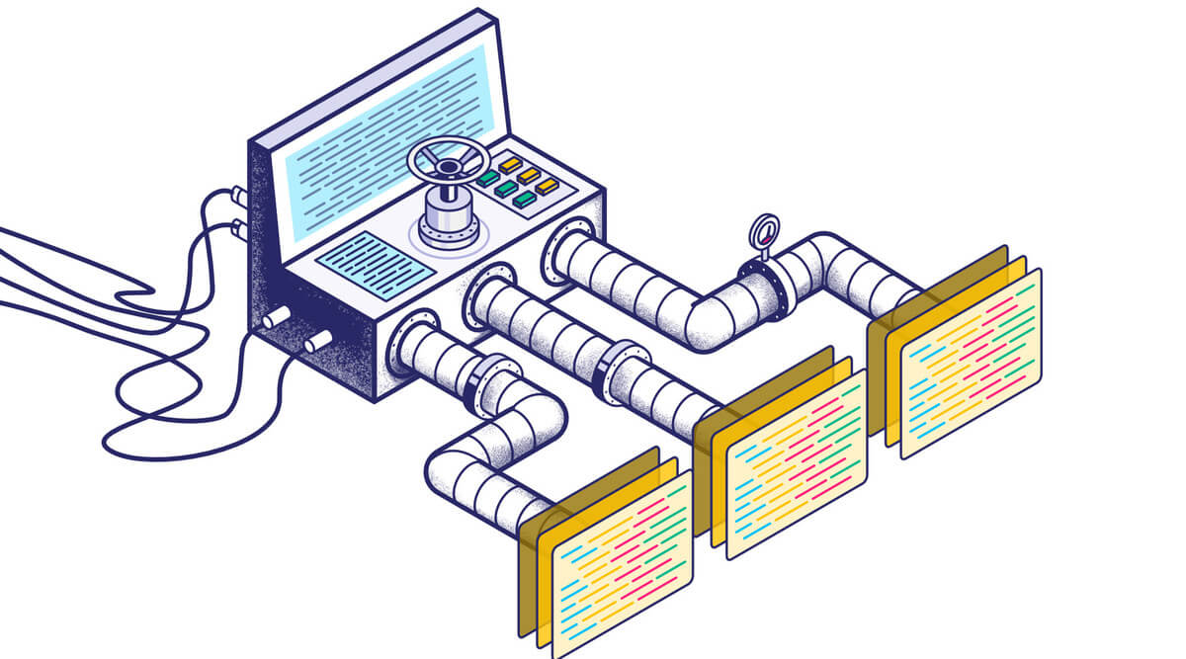
Defining Custom API Objects(17/28)
Understanding What the Website Controller Does :
  The API server also sends a “DELETED” watch event when a “Website” resource instance is deleted. Upon receiving the event, the controller deletes the Deployment and the Service resources it created earlier. As soon as a user deletes the “Website” instance, the controller will shut down and remove the web server serving that website.
  NOTE : The oversimplified controller isn’t implemented properly. The way it watches the API objects doesn’t guarantee it won’t miss individual watch events. The proper way to watch objects through the API server is to not only watch them, but also periodically re-list all objects in case any watch events were missed.

Slide 21
Defining Custom API Objects(18/28)
Running the Controller as a Pod :
  During development, you can the controller on your local development laptop and use a locally running “kubectl proxy” process (not running as a pod) as the ambassador to the Kubernetes API server. This allows you to develop quickly, because you don’t need to build a container image after every change to the source code and then run it inside Kubernetes.
  When you are ready to deploy the controller into production, the best way is to run the controller inside Kubernetes itself, the way you do with all the other core controllers. To run the controller in Kubernetes, you can deploy it through a “Deployment” resource. The following listing shows an example of such a Deployment.
apiVersion: apps/v1
kind: Deployment
metadata:
name: website-controller
spec:
replicas: 1
template:
metadata:
name: website-controller
labels:
app: website-controller
spec:
serviceAccountName: website-controller
containers:
- name: main
image: knix008/website-controller
- name: proxy
image: knix008/kubectl-proxy:latest
website-controller.yaml

Slide 22
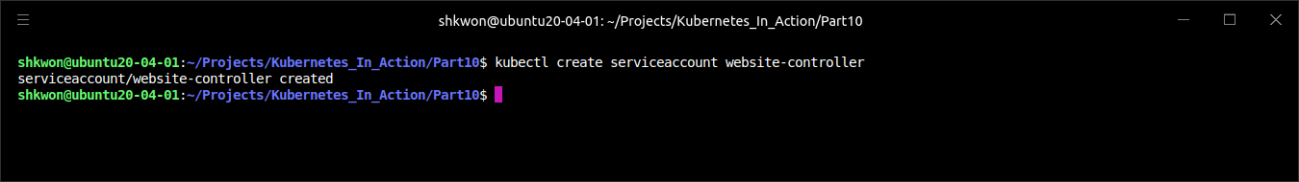
Defining Custom API Objects(19/28)
Running the Controller as a Pod :
  As you can see, the Deployment deploys a single replica of a two-container pod. One container runs your controller, whereas the other one is the “ambassador” container used for simpler communication with the API server. The pod runs under its own special “ServiceAccount”, so you’ll need to create it before you deploy the controller :
$ kubectl create serviceaccount website-controller

Slide 23
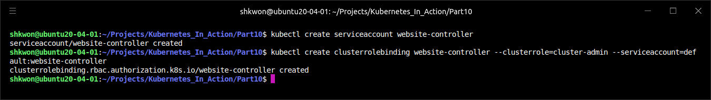
Defining Custom API Objects(20/28)
Running the Controller as a Pod :
  If “Role Based Access Control (RBAC)” is enabled in your cluster, Kubernetes will not allow the controller to watch Website resources or create Deployments or Services. To allow it to do that, you’ll need to bind the “website-controller” ServiceAccount to the cluster-admin “ClusterRole”, by creating a “ClusterRoleBinding” like this :
  Once you have the “ServiceAccount” and “ClusterRoleBinding” in place, you can deploy the controller’s Deployment.
$ kubectl create clusterrolebinding website-controller --clusterrole=cluster-admin --serviceaccount=default:website-controller

Slide 24
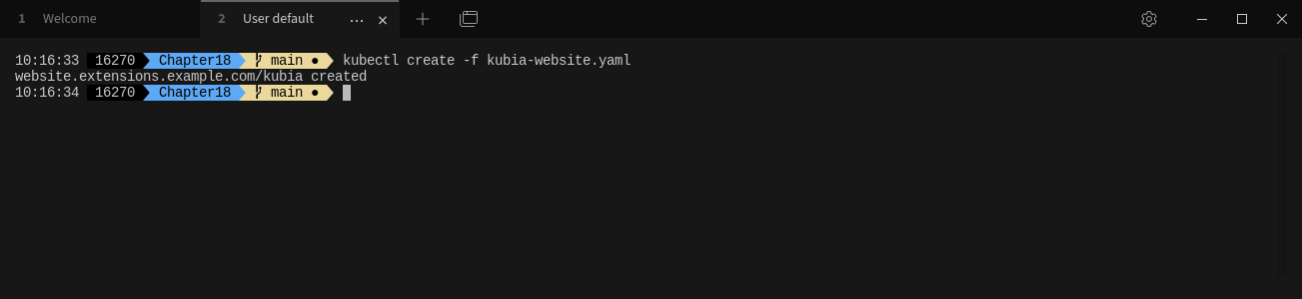
Defining Custom API Objects(21/28)
Seeing the Controller in Action :
  With the controller now running, create the “kubia Website resource” again :
$ kubectl create -f kubia-website.yaml

Slide 25
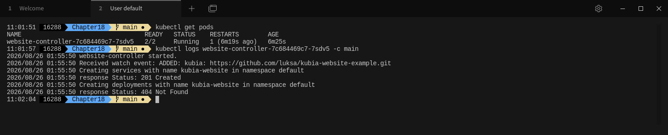
Defining Custom API Objects(22/28)
Seeing the Controller in Action :
  Now, let’s check the controller’s logs (shown in the following listing) to see if it has received the watch event.
  NOTE : The logs show that the controller received the ADDED event and that it created a Service and a Deployment for the kubia-website Website. The API server responded with a 201 Created response, which means the two resources should now exist.
$ kubectl get pods
$ kubectl logs website-controller-7c684469c7-7sdv5 -c main

Slide 26
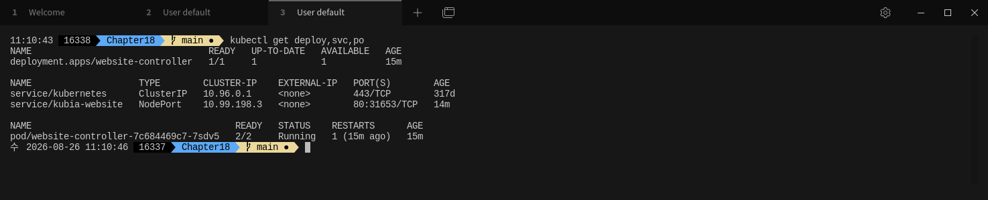
Defining Custom API Objects(23/28)
Seeing the Controller in Action :
  Let’s verify that the Deployment, Service and the resulting Pod were created. The following listing lists all Deployments, Services and Pods.
  NOTE : There they are. The kubia-website Service, through which you can access your website, is available on port “31653” on all cluster nodes. You can access it with your browser. Users of your Kubernetes cluster can now deploy static websites in seconds, without knowing anything about Pods, Services, or any other Kubernetes resources, except your custom Website resource.
  Obviously, you still have room for improvement. The controller could, for example, watch for Service objects and as soon as the node port is assigned, write the URL the website is accessible at into the status section of the Website resource instance itself. Or it could also create an Ingress object for each website.
$ kubectl get deploy,svc,po

Slide 27
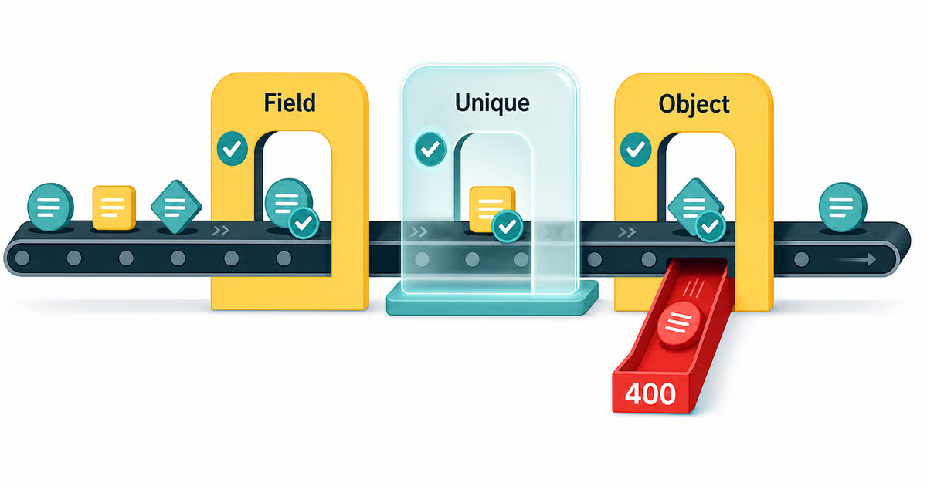
Defining Custom API Objects(24/28)
Validating custom objects :
  You may have noticed that you didn’t specify any kind of validation schema in the Website CustomResourceDefinition. Users can include any field they want in the YAML of their Website object. The API server doesn’t validate the contents of the YAML (except the usual fields like apiVersion, kind, and metadata), so users can create invalid Website objects (without a gitRepo field, for example).
  Is it possible to add validation to the controller and prevent invalid objects from being accepted by the API server? It isn’t, because the API server first stores the object, then returns a success response to the client (kubectl), and only then notifies all the watchers (the controller is one of them). All the controller can really do is validate the object when it receives it in a watch event, and if the object is invalid, write the error message to the Website object (by updating the object through a new request to the API server). The user wouldn’t be notified of the error automatically. They’d have to notice the error message by querying the API server for the Website object. Unless the user does this, they have no way of knowing whether the object is valid or not.
  This obviously isn’t ideal. You’d want the API server to validate the object and reject invalid objects immediately. Validation of custom objects was introduced in Kubernetes version 1.8 as an alpha feature. To have the API server validate your custom objects, you need to enable the “CustomResourceValidation” feature gate in the API server and specify a JSON schema in the CRD.

Slide 28
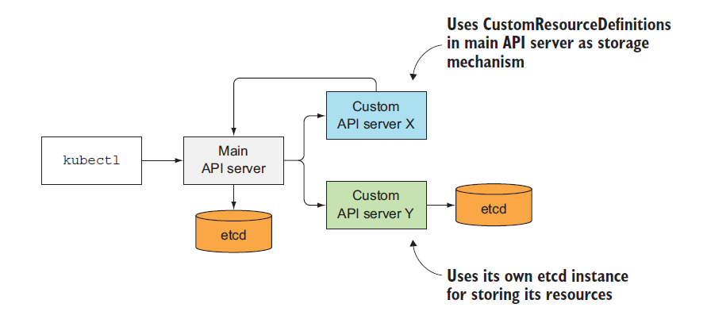
Defining Custom API Objects(25/28)
Providing a custom API server for your custom objects :
  A better way of adding support for custom objects in Kubernetes is to implement your own API server and have the clients talk directly to it.
  In Kubernetes version 1.7, you can integrate your custom API server with the main Kubernetes API server, through “API server aggregation”. Initially, the Kubernetes API server was a single monolithic component. From Kubernetes version 1.7, multiple aggregated API servers will be exposed at a single location. Clients can connect to the aggregated API and have their requests transparently forwarded to the appropriate API server. This way, the client wouldn’t even be aware that multiple API servers handle different objects behind the scenes. Even the core Kubernetes API server may eventually end up being split into multiple smaller API servers and exposed as a single server through the aggregator, as shown in the following figure.

Slide 29
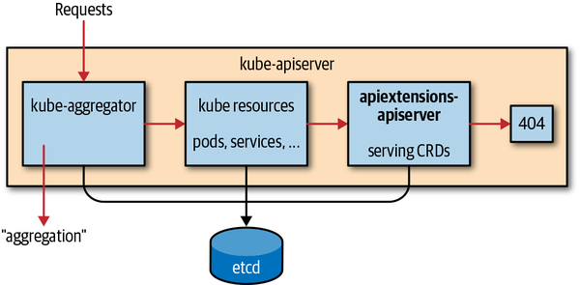
Defining Custom API Objects(26/28)
Providing a custom API server for your custom objects :
  In your case, you could create an API server responsible for handling your Website objects. It could validate those objects the way the core Kubernetes API server validates them. You’d no longer need to create a CRD to represent those objects, because you’d implement the Website object type into the custom API server directly.
  Generally, each API server is responsible for storing their own resources. As shown in the previous figure, it can either run its own instance of “etcd” (or a whole “etcd” cluster), or it can store its resources in the core API server’s etcd store by creating CRD instances in the core API server. In that case, it needs to create a CRD object first, before creating instances of the CRD, the way you did in the example.

Slide 30
Defining Custom API Objects(27/28)
Providing a custom API server for your custom objects :
  To add a custom API server to your cluster, you’d deploy it as a pod and expose it through a Service. Then, to integrate it into the main API server, you’d deploy a YAML manifest describing an “APIService resource” like the one in the following listing.
  NOTE : After creating the “APIService” resource from the above listing, client requests sent to the main API server that contain any resource from the “extensions.example.com API group” and version “v1” would be forwarded to the custom API server pod(s) exposed through the “website-api” Service.
apiVersion: apiregistration.k8s.io/v1
kind: APIService
metadata:
name: v1.extensions.example.com
spec:
group: extensions.example.com
version: v1
groupPriorityMinimum: 150
versionPriority: 15
service:
name: website-api
namespace: default
port: 443
insecureSkipTLSVerify: true
apiService.yaml

Slide 31
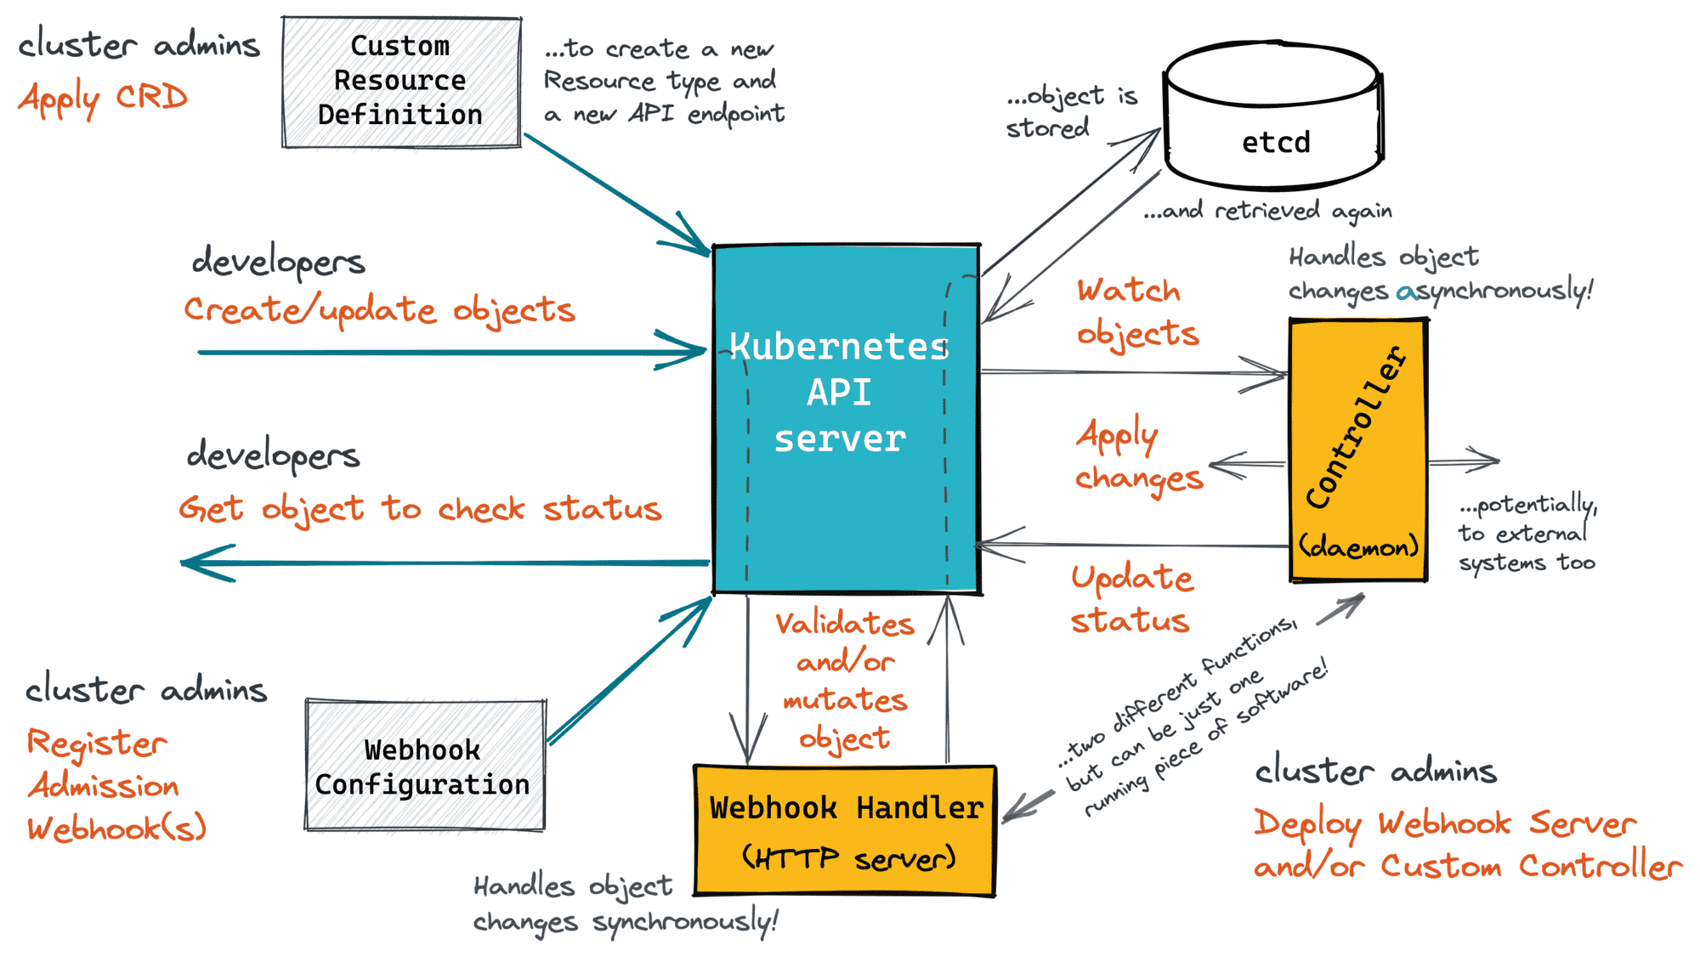
Defining Custom API Objects(28/28)
Providing a custom API server for your custom objects :
  While you can create custom resources from YAML files using the regular kubectl client, to make deployment of custom objects even easier, in addition to providing a custom API server, you can also build a custom CLI tool. This will allow you to add dedicated commands for manipulating those objects, similar to how kubectl allows creating Secrets, Deployments, and other resources through resource-specific commands like “kubectl create secret” or “kubectl create deployment”.
  Custom API servers, API server aggregation, and other features related to extending Kubernetes are currently being worked on intensively, so they may change in the future. To get up-to-date information on the subject, refer to the Kubernetes GitHub repos at http://github.com/kubernetes.

Slide 32
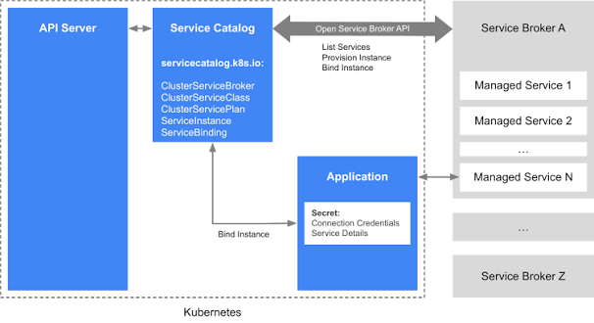
Extending Kubernetes with the Kubernetes Service Catalog(1/)
Service Catalog :
  One of the first additional API servers that will be added to Kubernetes through API server aggregation is the Service Catalog API server.
  Currently, for a pod to consume a service, someone needs to deploy the pods providing the service, a Service resource, and possibly a Secret so the client pod can use it to authenticate with the service. That someone is usually the same user deploying the client pod or, if a team is dedicated to deploying these types of general services, the user needs to file a ticket and wait for the team to provision the service. This means the user needs to either create the manifests for all the components of the service, know where to find an existing set of manifests, know how to configure it properly, and deploy it manually, or wait for the other team to do it.
  Kubernetes is supposed to be an easy-to-use, self-service system. Ideally, users whose apps require a certain service (for example, a web application requiring a backend database), should be able to say to Kubernetes. “Hey, I need a PostgreSQL database. Please provision one and tell me where and how I can connect to it.” This will soon be possible through the Kubernetes Service Catalog.

Slide 33
Extending Kubernetes with the Kubernetes Service Catalog(2/)
Introducing the Service Catalog :
  The Service Catalog is a catalog of services. Users can browse through the catalog and provision instances of the services listed in the catalog by themselves without having to deal with Pods, Services, ConfigMaps, and other resources required for the service to run.
  Instead of adding custom resources to the API server for each type of service, the Service Catalog introduces the following four generic API resources :
    A ClusterServiceBroker, which describes an (external) system that can provision services
    A ClusterServiceClass, which describes a type of service that can be provisioned
    A ServiceInstance, which is one instance of a service that has been provisioned
    A ServiceBinding, which represents a binding between a set of clients (pods) and a ServiceInstance

Slide 34
Extending Kubernetes with the Kubernetes Service Catalog(3/)
Introducing the Service Catalog :
  A cluster admin creates a ClusterServiceBroker resource for each service broker whose services they’d like to make available in the cluster. Kubernetes then asks the broker for a list of services that it can provide and creates a ClusterServiceClass resource for each of them. When a user requires a service to be provisioned, they create an ServiceInstance resource and the a ServiceBinding to bind that ServiceInstance to their pods. Those pods are then injected with a Secret that holds all the necessary credentials and other data required to connect to the provisioned ServiceInstance.

Slide 35
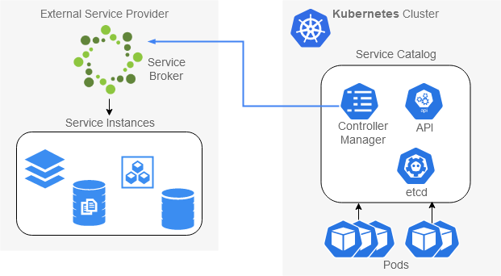
Extending Kubernetes with the Kubernetes Service Catalog(4/)
Introducing the Service Catalog API server and Controller Manager :
  Similar to core Kubernetes, the Service Catalog is a distributed system composed of three components:
    Service Catalog API Server
    etcd as the storage
    Controller Manager, where all the controllers run
  The four Service Catalog–related resources we introduced earlier are created by posting YAML/JSON manifests to the API server. It then stores them into its own etcd instance or uses CustomResourceDefinitions in the main API server as an alternative storage mechanism (in that case, no additional etcd instance is required).
  The controllers running in the Controller Manager are the ones doing something with those resources. They obviously talk to the Service Catalog API server, the way other core Kubernetes controllers talk to the core API server. Those controllers don’t provision the requested services themselves. They leave that up to external service brokers, which are registered by creating ServiceBroker resources in the Service Catalog API.

Slide 36
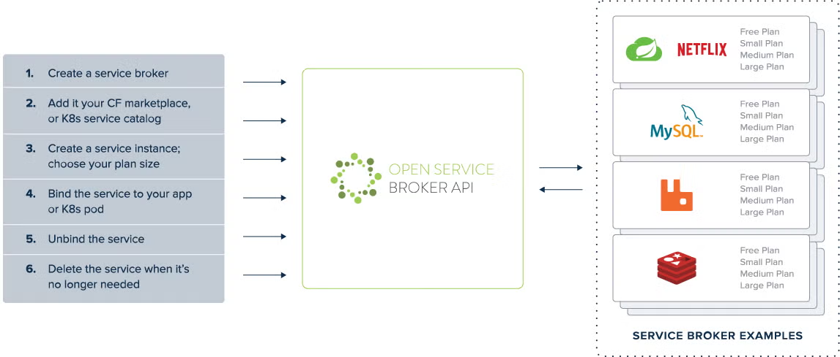
Extending Kubernetes with the Kubernetes Service Catalog(5/)
Introducing Service Brokers and the OpenServiceBroker API :
  A cluster administrator can register one or more external “ServiceBrokers” in the Service Catalog. Every broker must implement the “OpenServiceBroker API”.
  The Service Catalog talks to the broker through that API. The API’s a REST API providing the following operations :
    Retrieving the list of services with GET /v2/catalog
    Provisioning a service instance (PUT /v2/service_instances/:id)
    Updating a service instance (PATCH /v2/service_instances/:id)
    Binding a service instance (PUT /v2/service_instances/:id/service_bindings/:binding_id)
    Unbinding an instance (DELETE /v2/service_instances/:id/service_bindings/:binding_id)
    Deprovisioning a service instance (DELETE /v2/service_instances/:id)
  NOTE : You’ll find the OpenServiceBroker API spec at https://github.com/cloudfoundry/servicebroker.

Slide 37
Extending Kubernetes with the Kubernetes Service Catalog(6/)
Introducing Service Brokers and the OpenServiceBroker API :
  The cluster administrator registers a broker by posting a ServiceBroker resource manifest to the “Service Catalog API”, like the one shown in the following listing.
  NOTE : The listing describes an imaginary broker that can provision databases of different types. After the administrator creates the “ClusterServiceBroker“ resource, a controller in the “Service Catalog Controller Manager” connects to the URL specified in the resource to retrieve the list of services this broker can provision.
  After the “Service Catalog” retrieves the list of services, it creates a “ClusterService-Class” resource for each of them. Each “ClusterServiceClass” resource describes a single type of service that can be provisioned (an example of a ClusterServiceClass is “PostgreSQL database”). Each ClusterServiceClass has one or more service plans associated with it. These allow the user to choose the level of service they need (for example, a database ClusterServiceClass could provide a “Free” plan, where the size of the database is limited and the underlying storage is a spinning disk, and a “Premium” plan, with unlimited size and SSD storage).
apiVersion: servicecatalog.k8s.io/v1beta1
kind: ClusterServiceBroker
metadata:
name: database-broker
spec:
url: http://database-osbapi.myorganization.org
database-broker.yaml
Where the Service Catalog
can contact the broker
(its OpenServiceBroker [OSB] API URL)

Slide 38
Extending Kubernetes with the Kubernetes Service Catalog(7/)
Introducing Service Brokers and the OpenServiceBroker API :
  Users of the Kubernetes cluster can retrieve a list of all services that can be provisioned in the cluster with “kubectl get serviceclasses”, as shown in the following listing.
$ kubectl create -f database-broker.yaml
$ kubectl get clusterserviceclasses

Slide 39
>
:
  .

Slide 40
>
:
  .

Slide 41
>
:
  .

Slide 42
>
:
  .

Slide 43
>
:
  .

Slide 44
>
:
  .

Slide 45
>
:
  .

Slide 46
>
:
  .

Slide 47
>
:
  .

Slide 48
>
:
  .

Slide 49
>
:
  .

Slide 50
>
:
  .

Slide 51
>
:
  .

Slide 52
>
:
  .

Slide 53
>
:
  .

Slide 54
>
:
  .

Slide 55
>
:
  .

Slide 56
>
:
  .

Slide 57
>
:
  .

Slide 58
>
:
  .

Slide 59
>
:
  .

Slide 60
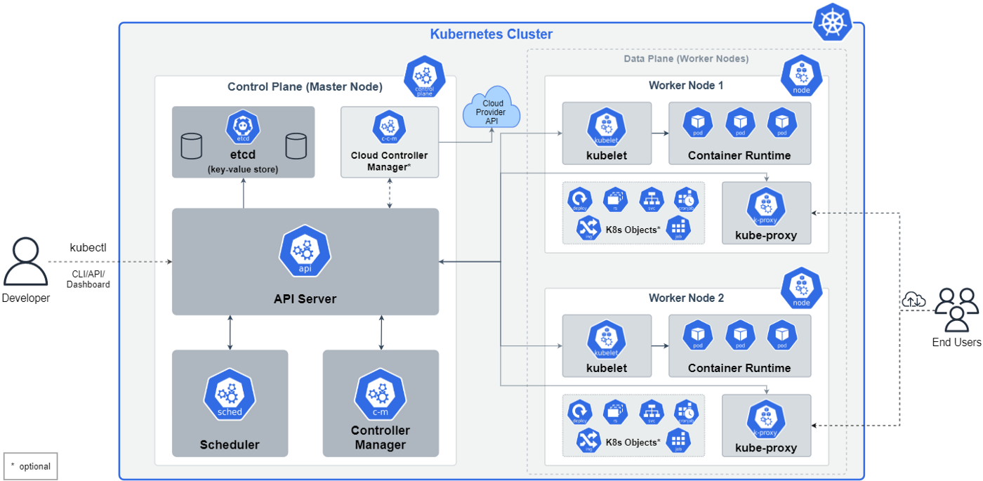
NOTE : Big Picture - The Kubernetes Cluster

Slide 61
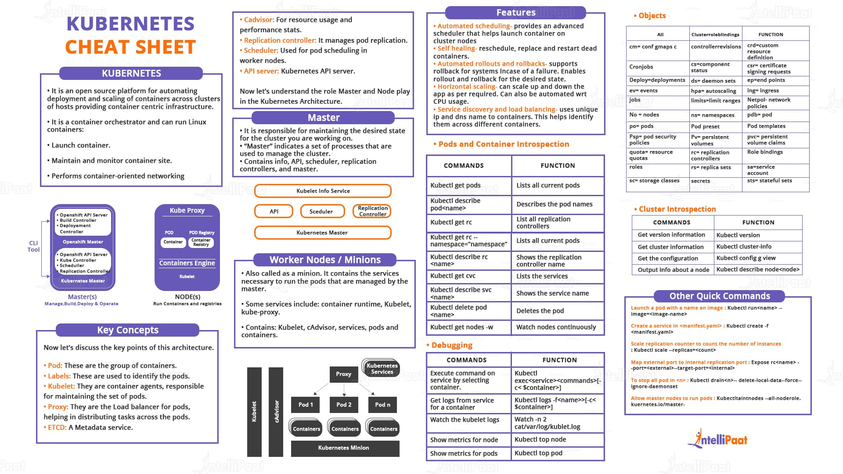
NOTE : Kubernetes Cheat Sheet

Slide 62
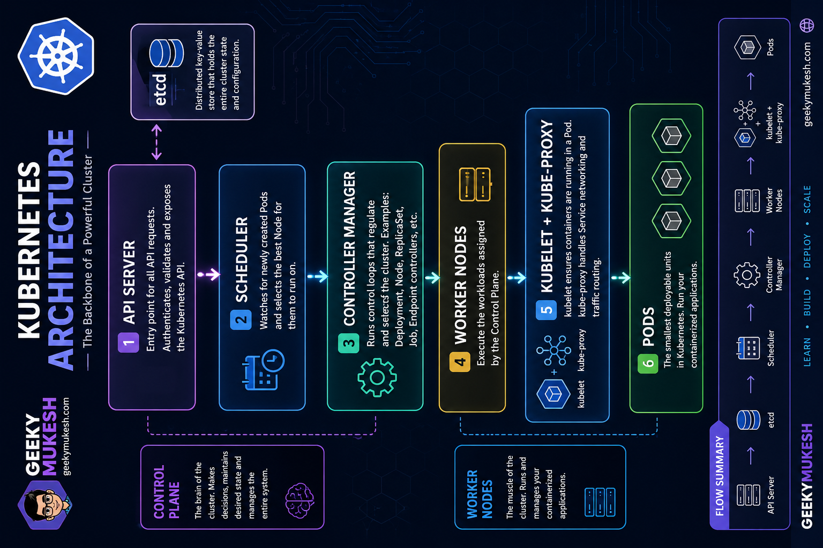
NOTE : Kubernetes Architecture

Slide 63

Reference
[1] Kubernetes in Action, Marko Luksa, Manning, 2018 1st Edition.
[2] https://github.com/luksa/kubernetes-in-action
[3] https://minikube.sigs.k8s.io/docs/
[4] https://kubernetes.io/docs/reference/kubectl/cheatsheet/

Slide 64

? & !

